Slide 1
Layout Managers

Slide 2
Layout Managers
Layout managers automate the positioning of components within containers.
They free the programmer from the difficult task of figuring out the space needed for each component and the pixel coordinate positions for each component.
If a user resizes the window, the layout manager takes that into account and adjusts the layout accordingly.
If a programmer adjusts a component's size (e.g., by changing a label's font size), the layout manager takes that into account and adjusts the layout accordingly.

Slide 3
The Five Most Common LayoutManager Classes
FlowLayout
BoxLayout
BorderLayout
GridLayout
GridBagLayout
The BoxLayout class is in the javax.swing package.
The other classes are in the java.awt package.

Slide 4
To Assign a LayoutManager to a JFrame
Call the setLayout method on the Jframe object and pass an anonymous object of the chosen Layout class.
frame.setLayout(new GridLayout(1,0));
Or, pass the anonymous layout object to the constructor of a JPanel.
JPanel panel = new JPanel(new GridLayout(1,0));
If there has been no layout assigned to the Jframe, it is by default, a BorderLayout. If a layout has been assigned, the panel will be added to an appropriate location in that layout.
For a Border Layout: frame.add(panel, BorderLayout.CENTER);

Slide 5
FLowLayout
The FlowLayout class implements a simple one-compartment layout scheme that allows multiple components.
When a component is added to the compartment, it is placed to the right of any components that are already there.
If there is not enough room to add a component to the right of previously added components, then the new component is placed on the next line (i.e., it "flows" to the next line).

Slide 6
FlowLayout Alignment
By default, components are placed in a FlowLayout container using top, center alignment.
There's no way to change the vertical alignment. But we can change the horizontal alignment.
Insert one of the FlowLayout alignment constants (FlowLayout.LEFT, FlowLayout.CENTER, FlowLayout.RIGHT) in the FlowLayout constructor call.
For example, here's how to specify left alignment:
setLayout(new FlowLayout(FlowLayout.LEFT));

Slide 7
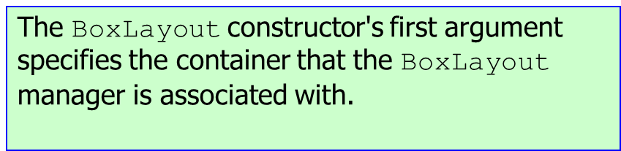
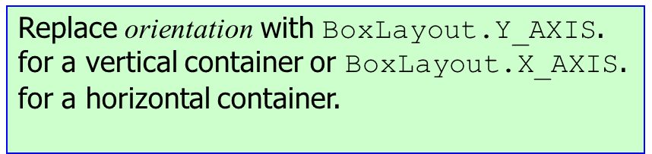
BoxLayout
The BoxLayout manager arranges components in either a single row or a single column.
There is no wrap around, long components are cut off.
If you call setLayout :
setLayout(new BoxLayout(getContentPane(), BoxLayout.orientation));

Slide 8

BoxLayout Manager Example
The program creates the window at the right by using a BoxLayout manager and adding the JLabel components to it in the order that they were added to the window.

Slide 9
BorderLayout Manager
The BorderLayout manager provides five regions or compartments in which to insert components.
NORTH
SOUTH
EAST
WEST
CENTER

Slide 10
BorderLayout Constructors
Here are the constructors defined by BorderLayout:
BorderLayout() //default border layout.
BorderLayout(int horiz, int vert) //specify the horizontal and vertical space left between components in horz and vert, respectively.

Slide 11
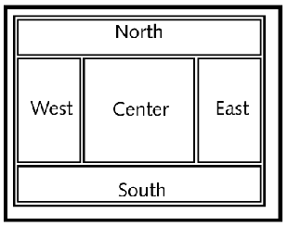
The sizes of the five regions are determined as shown below.
West's contents determine this divider's position.
East's contents determine this divider's position.
North's contents determine this divider's position.
South's contents determine this divider's position.

Slide 12
How the Regions Resize
If an outer region (North, South, East, West) is empty, it collapses so that it does not take up any space.
If the north region is empty the west, center and east regions expand up.
If the east and south regions are both empty the center region expands right and then the center and west regions expand down.
If the center region is empty nothing happens, because the center region doesn’t control any of the dividing lines.

Slide 13
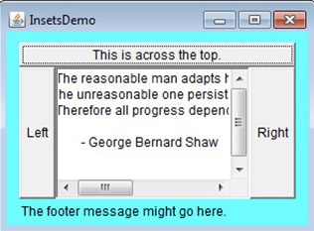
Using Insets
Sometimes you will want to leave a small amount of space between the container that holds your components and the window that contains it. To do this, override the getInsets( ) method that is defined by Container. This method returns an Insets object that contains the top, bottom, left, and right inset to be used when the container is displayed. These values are used by the layout manager to inset the components when it lays out the window.
The constructor for Insets: Insets(int top, int left, int bottom, int right)
Override getInsets method to add inset values:
public static getInsets(){
return Insets(40, 20, 10, 20);
}
Example shows cyan-colored insets ->

Slide 14
Additional Constants for the Border Layout
static String AFTER_LAST_LINE − Synonym for PAGE_END.
static String AFTER_LINE_ENDS − Synonym for LINE_END.
static String BEFORE_FIRST_LINE − Synonym for PAGE_START.
static String BEFORE_LINE_BEGINS − Synonym for LINE_START.
static String LINE_END − The component goes at the end of the line direction for the layout.
static String LINE_START − The component goes at the beginning of the line direction for the layout.
static String PAGE_END − The component comes after the last line of the layout's content.
static String PAGE_START − The component comes before the first line of the layout's content.

Slide 15
Adding Multiple Components to a Region
With a BorderLayout container, you can add only five components total, one for each of the five regions.
If you add a component to a region that already has a component, then the new component overlays the old component.
To add multiple components to a region in the BorderLayout, first create a JPanel or other container, and add the components to the JPanel.
Then add the JPanel to the BorderLayout region.

Slide 16
Label Alignment
To specify a label's alignment within a BorderLayout region, instantiate the label with an alignment constant like this:
new JLabel(<label's-text>, <alignment-constant>)
Replace <alignment-constant> by one of these named constants:
SwingConstants.LEFT,
SwingConstants.CENTER,
SwingConstants.RIGHT
Here's an example that adds a center-aligned label to a BorderLayout north region:
add(new JLabel("Tunisia", SwingConstants.CENTER),
BorderLayout.NORTH);

Slide 17
Swing Constants
SwingConstants is an interface, defined in the javax.swing package.
SwingConstants stores a set of GUI-related constants that are commonly used by many different GUI programs.
To access a named constant in an interface, prefix it with the interface name.
For example, to access the LEFT alignment constant, prefix LEFT with SwingConstants like this: SwingConstants.LEFT.

Slide 18
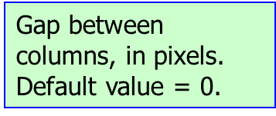


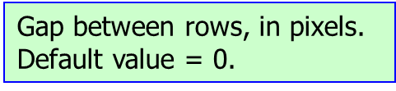
The GridLayout Manager
A container's components are laid out in a rectangular grid. The grid is divided into equal-sized cells. Each cell can hold only one component.
To specify the use of a GridLayout manager for a container, call setLayout like this:
setLayout(new GridLayout(rows, cols, hGap, vGap));

Slide 19
Adding Components
Call the add method like this: add(<component>);
The GridLayout manager positions components within the container using left-to-right, top-to-bottom order.
The first added component goes in the top-left-corner cell, the next added component goes in the cell to the right of the first component, etc.

Slide 20
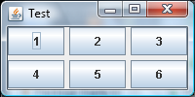
GridLayout Manager Example
Create a two-row, three-column table with six buttons:
setLayout(new GridLayout(2, 3, 5, 5));
add(new JButton("1"));
add(new JButton("2"));
add(new JButton("3"));
add(new JButton("4"));
add(new JButton("5"));
add(new JButton("6"));
vertical gap = 5 pixels
horizontal gap = 5 pixels
Notes:
1. Assuming that the code fragment is part of a complete, working program, this is what the program displays.
2. The six rectangles you see are the six cells, but they're also the six buttons.
The buttons are the same size as the cells because, with a GridLayout manager, components expand to fill their cells.
That should sound familiar; BorderLayout components do the same thing.
3. When creating a GridLayout manager, you call the GridLayout constructor with a number-of-rows argument and a number-of-columns argument.
Those two arguments require some additional explanation.
To help with the explanation, consider three different cases…

Slide 21
Specifying Number of Rows and Columns
CASE 1:
If you know the number of rows and columns in your table and the table is completely filled in (i.e., there are no empty cells), call the GridLayout constructor with the actual number of rows and the actual number of columns.

Slide 22
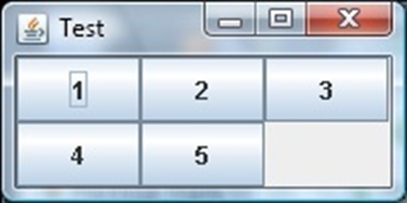
CASE 2: A Row-Oriented Display
Call the GridLayout constructor with the actual number of rows for the rows argument and 0 for the columns argument.
A 0 for the columns argument indicates that you're leaving it up to the GridLayout manager to determine the number of columns.
Ex. If you assign a container' layout like this:
setLayout(new GridLayout(2, 0));
And you add 5 buttons to the container:

Slide 23
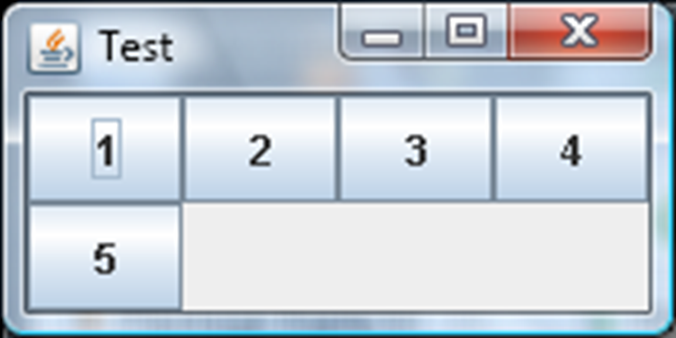
CASE 3: A Column-Oriented Display
Call the GridLayout constructor with the actual number of columns for the columns argument and 0 for the rows argument.
Ex. If you assign a container's layout like this: setLayout(new GridLayout(0, 4));
And add 5 buttons to the container:

Slide 24
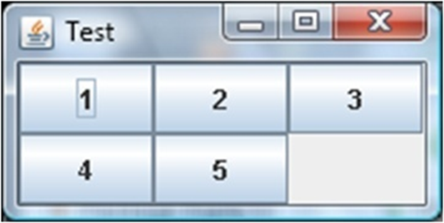
Common Errors
If you call the GridLayout constructor with 0's for both the rows and columns arguments, you'll get a compilation error; i.e., this generates a compilation error:
setLayout(new GridLayout(0, 0));
If you call the GridLayout constructor with non-0's for both the rows and columns arguments and your table is not completely filled, you may get unexpected results.
For example, the previous slide's four-column window is not completely filled. Suppose you accidentally specify a value for the rows argument:
setLayout(new GridLayout(2, 4));
After adding 5 components to the container, here's the resulting display:

Slide 25
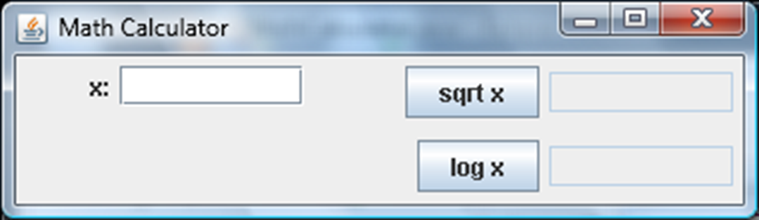
Which Layout Manager Scheme Should be Used for this Calculator?
How many rows and columns do you see?
The GridLayout manager is usually pretty good at positioning components in an organized tabular fashion, but it's limited by the fact that each of its cells must be the same size.
Would a FlowLayout manager work?

Slide 26
Gridbag Layout
The “grid” in GridBagLayout is exactly that, a rectangular container divvied up into various rows and columns.
The “bag” part, though, comes from a sort of grab bag notion of how you use the cells created by those rows and columns.
The rows and columns can each have their own height or width, and components can occupy any rectangular collection of cells.
We can take advantage of this flexibility to build out an Apple game interface with a single JPanel rather than with several nested panes.
The next Slide shows one way of carving up the screen into four rows and three columns, and then placing the components.

Slide 27
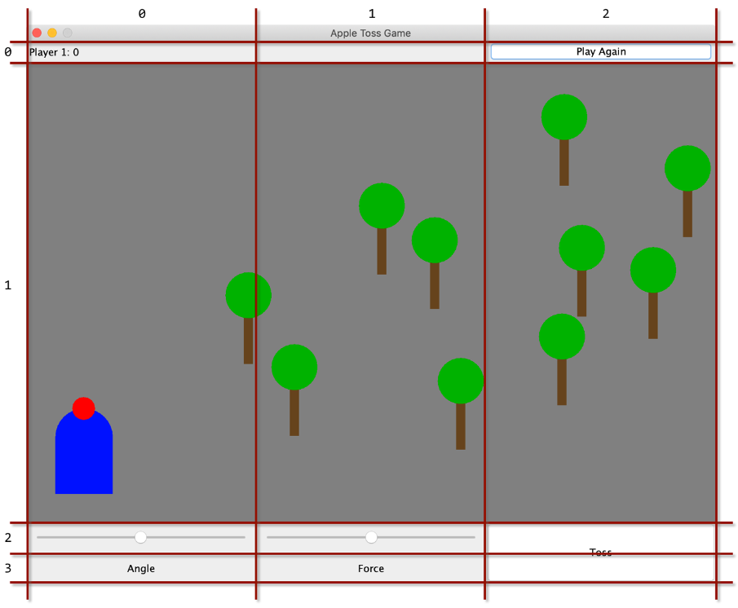

Slide 28
Work on the Apple Game Layout
You can see the different row heights and column widths.
And notice how some components occupy more than one cell.
This type of arrangement won’t work for every application, but it is powerful and works for many UIs that need more than simple layouts.
To build an application with a GridBagLayout, you need to keep a couple of references around as you add components.

Slide 29
Set up the Grid
public static final int SCORE_HEIGHT = 30;
public static final int CONTROL_WIDTH = 300;
public static final int CONTROL_HEIGHT = 40;
public static final int FIELD_WIDTH = 3 * CONTROL_WIDTH;
public static final int FIELD_HEIGHT = 2 * CONTROL_WIDTH;
public static final float FORCE_SCALE = 0.7f;
GridBagLayout gameLayout = new GridBagLayout();
gameLayout.columnWidths = new int[]
{ CONTROL_WIDTH, CONTROL_WIDTH, CONTROL_WIDTH };
gameLayout.rowHeights = new int[]
{ SCORE_HEIGHT, FIELD_HEIGHT, CONTROL_HEIGHT, CONTROL_HEIGHT };
JPanel gamePane = new JPanel(gameLayout);

Slide 30
Add Game Components
To get those components added, you need to create and configure a GridBagConstraints object.
Fortunately, you can reuse the same object for all of your components—you just need to repeat the configuration portion before adding each element.
Here’s how to add the main playing field component:
GridBagConstraints gameConstraints = new GridBagConstraints();
gameConstraints.fill = GridBagConstraints.BOTH;
gameConstraints.gridy = 1;
gameConstraints.gridx = 0;
gameConstraints.gridheight = 1;
gameConstraints.gridwidth = 3;
Field field = new Field();
gamePane.add(field, gameConstraints);

Slide 31
Setting Fields into Cells
Notice how we set which cells the field will occupy.
This is the core of configuring grid bag constraints.
You can also adjust things like how a component will fill the cells it occupies and how much of a margin each component gets.
We’ve settled on simply filling all of the space available in a group of cells (“both” a horizontal fill and a vertical fill), but you can read about more options in the documentation for GridBagConstraints.

Slide 32
Add a ScoreKeeping Label at the Top
gameConstraints.fill = GridBagConstraints.BOTH;
gameConstraints.gridy = 0;
gameConstraints.gridx = 0;
gameConstraints.gridheight = 1;
gameConstraints.gridwidth = 1;
JLabel scoreLabel = new JLabel(" Player 1: 0");
gamePane.add(scoreLabel, gameConstraints);

Slide 33
DRY: Create a Function
Notice how similar the setup of the constraints is to how we handled the game field? Put them into a function:
private GridBagConstraints buildConstraints(int row, int col,
int rowspan, int colspan) {
// Use our global reference to the gameConstraints object
gameConstraints.fill = GridBagConstraints.BOTH;
gameConstraints.gridy = row;
gameConstraints.gridx = col;
gameConstraints.gridheight = rowspan;
gameConstraints.gridwidth = colspan;
return gameConstraints;
}

Slide 34
Rewrite the Earlier Blocks of Code for the score label and game field
GridBagConstraints gameConstraints = new GridBagConstraints();
JLabel scoreLabel = new JLabel(" Player 1: 0");
Field field = new Field();
gamePane.add(scoreLabel, buildConstraints(0,0,1,1));
gamePane.add(field, buildConstraints(1,0,1,3));

Slide 35
Add other Components
With that function in place, we can quickly add the various other components and labels we want to complete our game interface. For example, the toss button in the lower-right corner of the layout can be set up like this:
JLabel tossButton = new JButton("Toss");
gamePane.add(tossButton, buildConstraints(2,2,2,1));

